Slide 1

TICKETZ
By: Bettina, Enikő, Lilla

Slide 2
Technologies Used
Frontend
Backend
Database
Design

Slide 3
Technologies Used
Frontend
Backend
Database
Design
HTML
CSS
JavaScript

Slide 4
Technologies Used
Frontend
Backend
Database
Design
HTML
CSS
JavaScript
Java
RestAPI
JWT

Slide 5
Technologies Used
Frontend
Backend
Database
Design
HTML
CSS
JavaScript
Java
RestAPI
JWT
MySQL

Slide 6
Technologies Used
Frontend
Backend
Database
Design
HTML
CSS
JavaScript
Java
RestAPI
JWT
MySQL
Figma

Slide 7
Our project
Ticket purchase for Cinema/Theater
Seats – You can choose from the seatmap
Weekly recommendations
register/ login
Responsive, clean UI

Slide 8
Team
Enikő
Bettina
(PM)
Lilla
Database
Figma
Backend
Figma
Frontend
Documentation

Slide 9
Why Choose Us?
User-friendly and modern design
Fast and simple booking process
Secure data handling
Clear and logical system structure
We focus on creating practical, reliable, and elegant digital solutions.

Slide 10
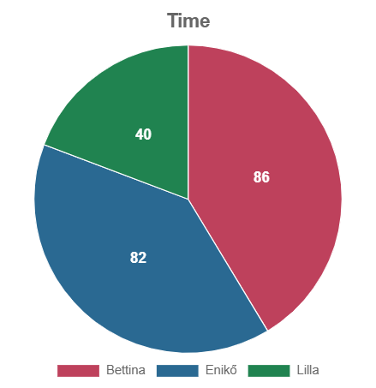
Time investment

Slide 11
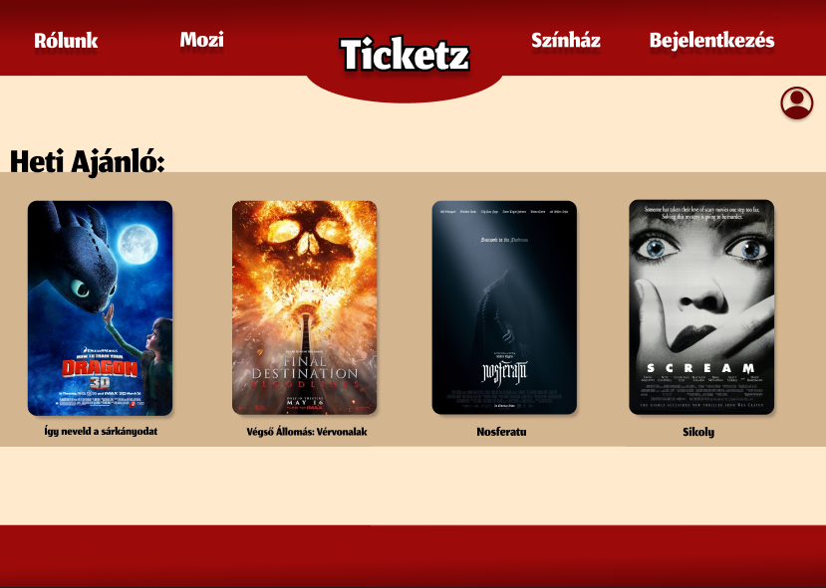
Design inDEvestment

Slide 12
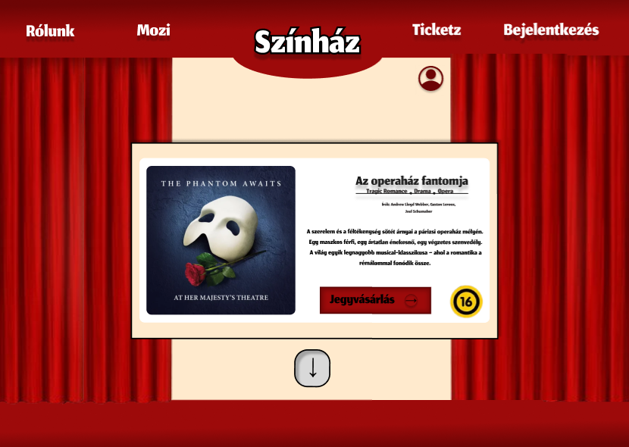
Design inDEvestment

Slide 13
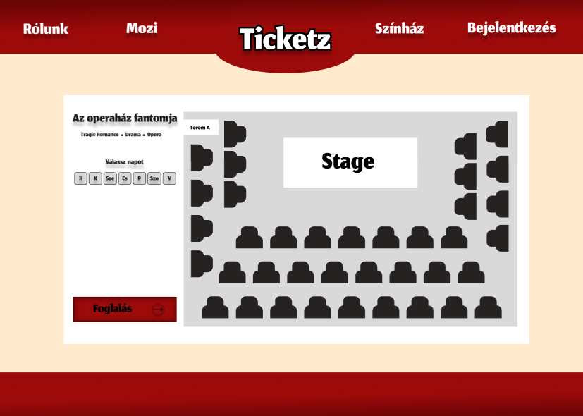
Design inDEvestment

Slide 14
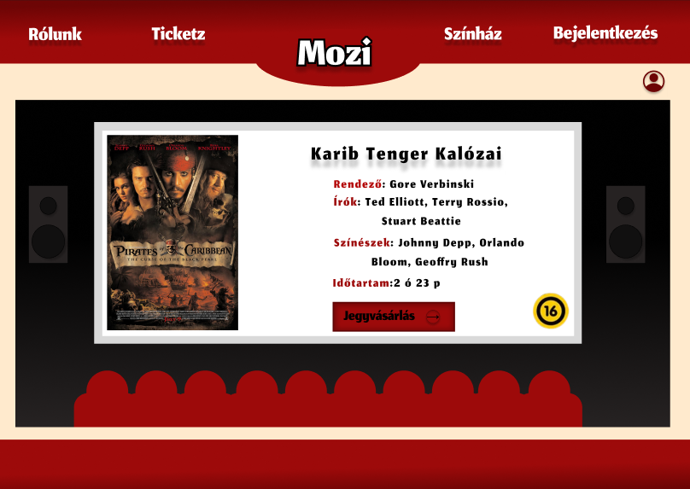
Design inDEvestment

Slide 15
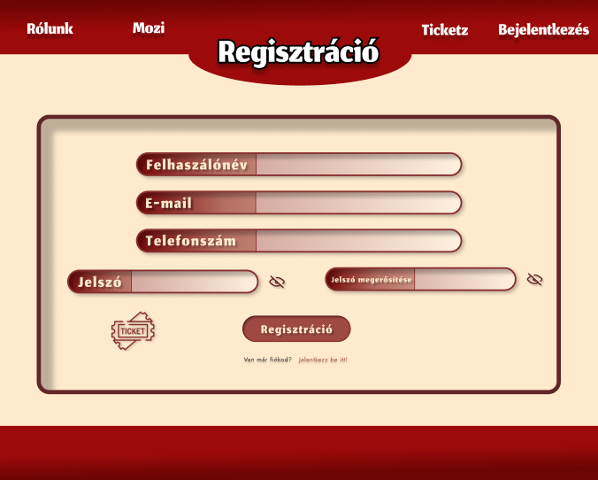
Design inDEvestment

Slide 16
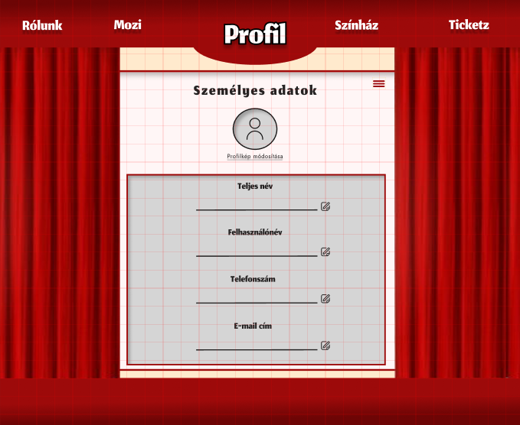
Design inDEvestment

Slide 17
Design
Future plan
Add card details to profile
Online payment integration
Improved user features

Slide 18
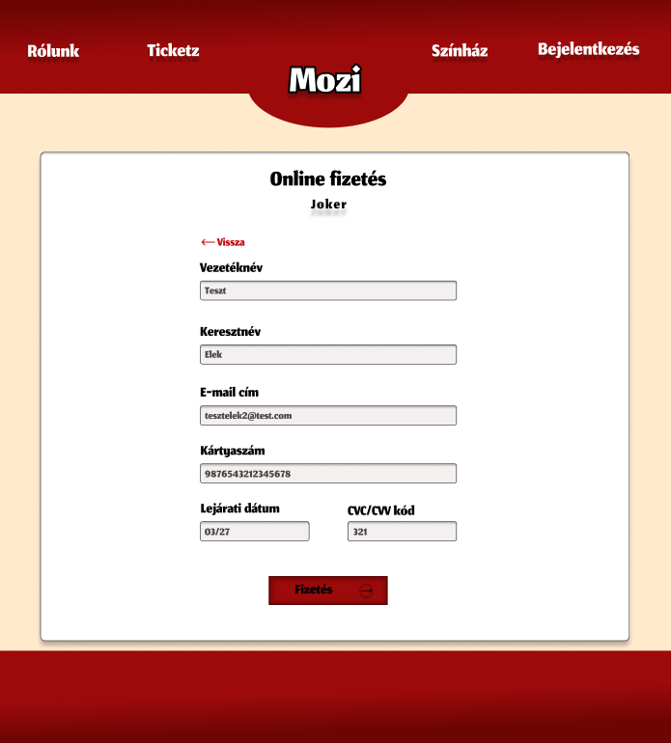

Slide 19
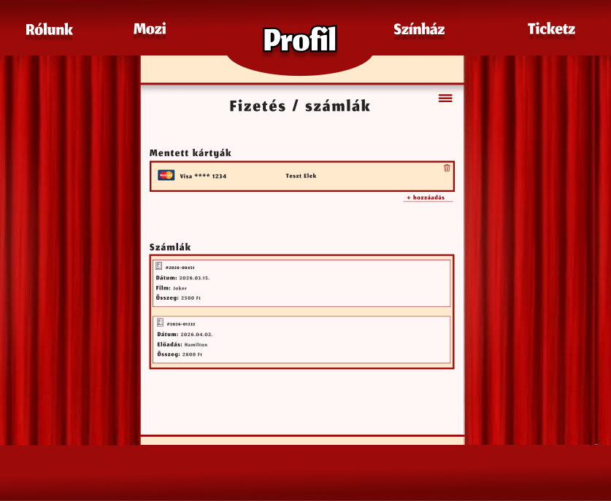

Slide 20
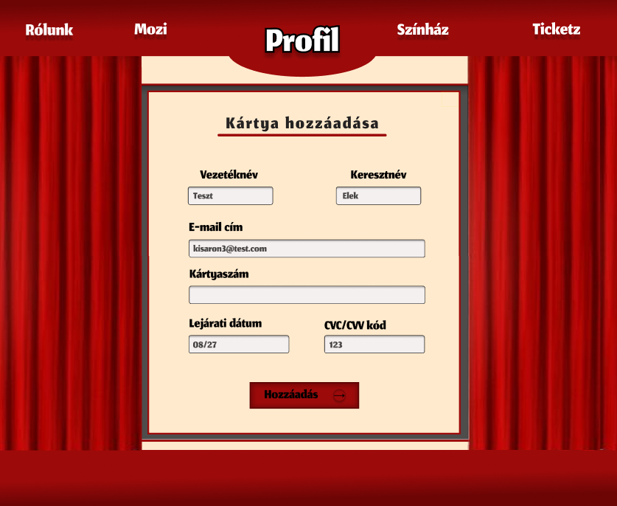

Slide 21
Frontend
Provides the user interface of the system
Ensures smooth user interaction
Displays dynamic data from the backend
Handles form validation and user input
Improves overall user experience

Slide 22
Frontend
Users must easily browse events
Seat selection must be clear and interactive
The booking process must be simple and intuitive
Responsive design ensures accessibility on different devices

Slide 23
Backend
Handles business logic
Processes booking requests
Communicates with the database
Validates data before storing it
Logging in

Slide 24
Backend
Prevents double booking
Manages seat availability
Rest Api
Connects frontend with the database

Slide 25
Database
Strong data integrity with primary and foreign keys
Structured and organized data storage
Clear relationships between tables
Support for transactions

Slide 26
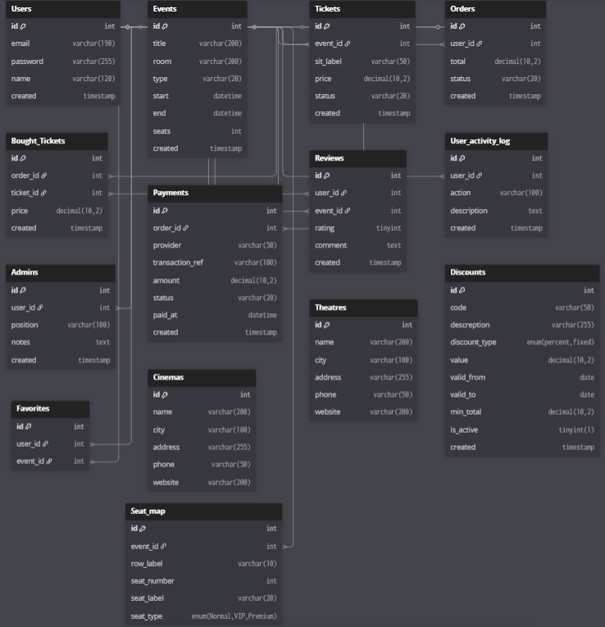

Slide 27
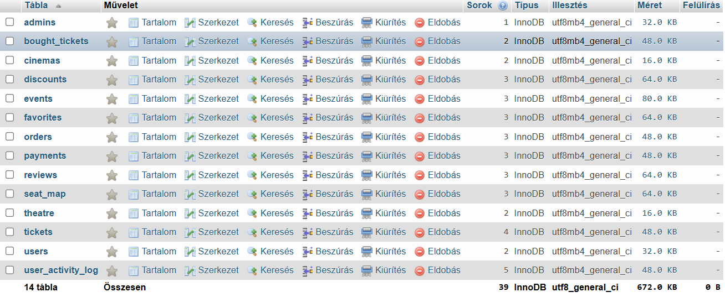
Tables

Slide 28
Stored procedures
Create order
Reserve tickets
Cancel reservation
Calculate revenue

Slide 29
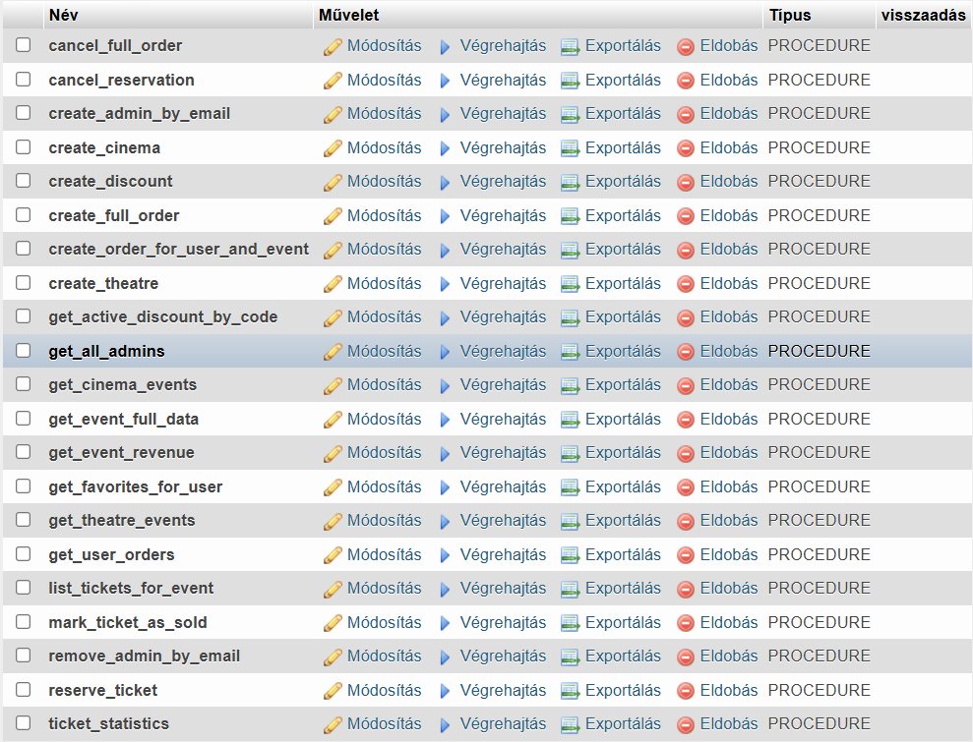
Stored procedures

Slide 30
Transactions & Safety
START TRANSACTION
COMMIT
Prevent partial data
Data consistency

Slide 31

Tests

Slide 32
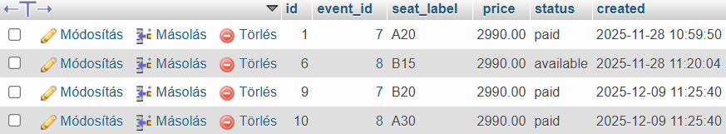
Tests

Slide 33
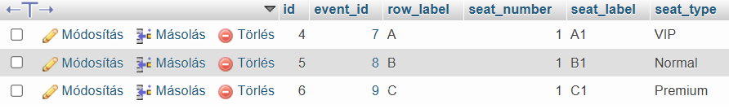
Tests

Slide 34
Thank you for your attention!

